Slide 1
Business Statistics:
A First Course
(3rd Edition)
Chapter 3
Numerical Descriptive Measures

Slide 2
Chapter Topics
Measures of Central Tendency
  Mean, Median, Mode, Geometric Mean
Quartile
Measure of Variation
  Range, Interquartile Range, Variance and Standard Deviation, Coefficient of Variation
Shape
  Symmetric, Skewed, using Box-and-Whisker Plots

Slide 3
Chapter Topics
(continued)
Coefficient of Correlation
Pitfalls in Numerical Descriptive Measures and Ethical Issues

Slide 4
Summary Measures
Summary Measures
Central Tendency
Quartile
Variation
Mean
Mode
Median
Range
Coefficient of Variation
Variance
Standard Deviation
Geometric Mean

Slide 5
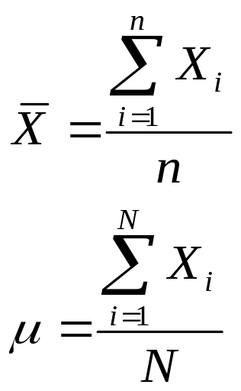
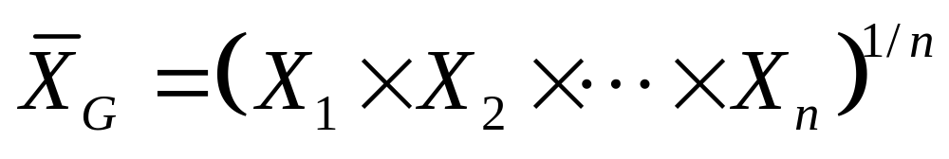
Measures of Central Tendency
Central Tendency
Mean
Median
Mode
Geometric Mean

Slide 6
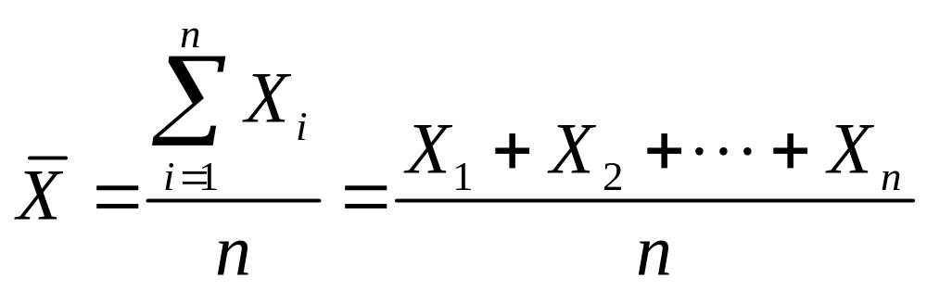
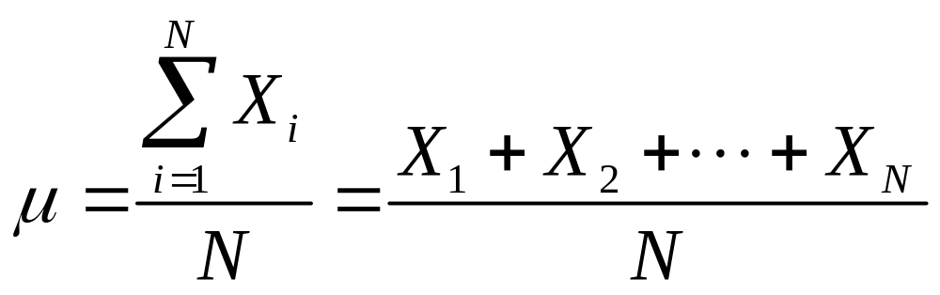
Mean (Arithmetic Mean)
Mean (Arithmetic Mean) of Data Values
  Sample mean
  Population mean
Sample Size
Population Size

Slide 7
Mean (Arithmetic Mean)
(continued)
The Most Common Measure of Central Tendency
Affected by Extreme Values (Outliers)
0 1 2 3 4 5 6 7 8 9 10
0 1 2 3 4 5 6 7 8 9 10 12 14
Mean = 5
Mean = 6

Slide 8
Median
Robust Measure of Central Tendency
Not Affected by Extreme Values
In an Ordered Array, the Median is the ‘Middle’ Number
  If n or N is odd, the median is the middle number
  If n or N is even, the median is the average of the 2 middle numbers
0 1 2 3 4 5 6 7 8 9 10
0 1 2 3 4 5 6 7 8 9 10 12 14
Median = 5
Median = 5

Slide 9
Mode
A Measure of Central Tendency
Value that Occurs Most Often
Not Affected by Extreme Values
There May Not be a Mode
There May be Several Modes
Used for Either Numerical or Categorical Data
0 1 2 3 4 5 6
0 1 2 3 4 5 6 7 8 9 10 11 12 13 14
No Mode
Mode = 9

Slide 10
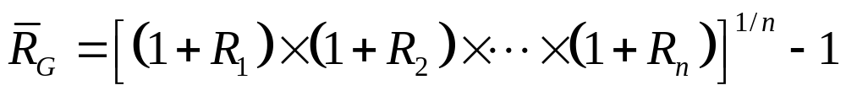
Geometric Mean
Useful in the Measure of Rate of Change of a Variable over Time
Geometric Mean Rate of Return
  Measures the status of an investment over time

Slide 11
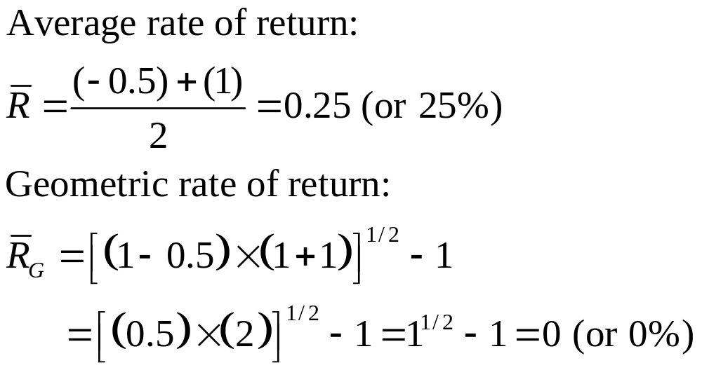
Example
An Investment of $100,000 declined to $50,000 at the end of year one and rebounded back to $100,000 at end of year two:

Slide 12
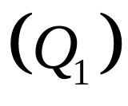
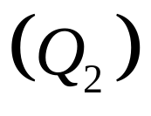
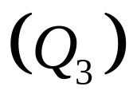
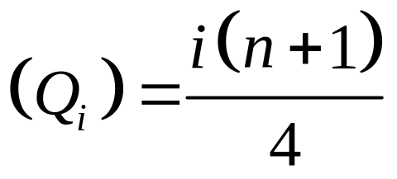
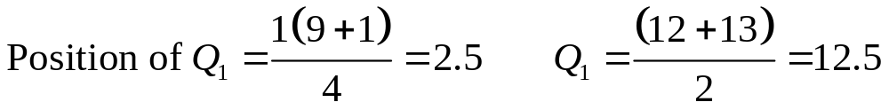
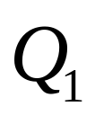
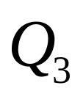
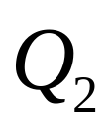
Quartiles
Split Ordered Data into 4 Quarters
Position of i-th Quartile
and Are Measures of Noncentral Location
= Median, A Measure of Central Tendency
25%
25%
25%
25%
Data in Ordered Array: 11 12 13 16 16 17 18 21 22

Slide 13
Measures of Variation
Variation
Variance
Standard Deviation
Coefficient of Variation
Range
Population
Variance
Population
Standard
Deviation
Sample
Variance
Sample
Standard
Deviation
Interquartile Range

Slide 14

Range
Measure of Variation
Difference between the Largest and the Smallest Observations:
Ignores How Data are Distributed
Range = 12 - 7 = 5
Range = 12 - 7 = 5
7 8 9 10 11 12
7 8 9 10 11 12

Slide 15
Interquartile Range
Measure of Variation
Also Known as Midspread
  Spread in the middle 50%
Difference between the First and Third Quartiles
Not Affected by Extreme Values
Data in Ordered Array: 11 12 13 16 16 17 17 18 21

Slide 16
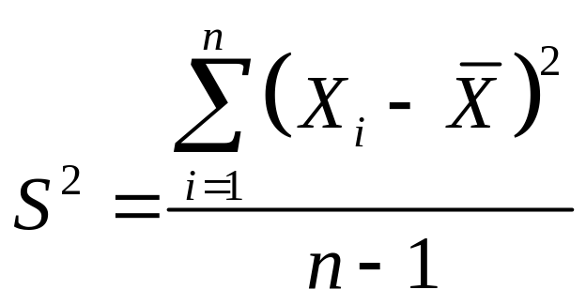
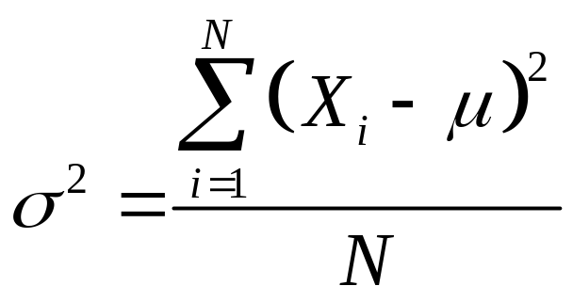
Variance
Important Measure of Variation
Shows Variation About the Mean
  Sample Variance:
  Population Variance:

Slide 17
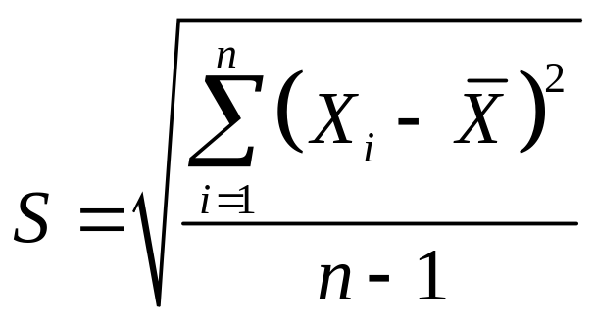
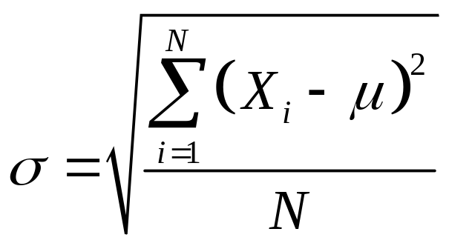
Standard Deviation
Most Important Measure of Variation
Shows Variation about the Mean
Has the Same Units as the Original Data
  Sample Standard Deviation:
  Population Standard Deviation:

Slide 18
Comparing Standard Deviations
Data A
Mean = 15.5
s = 3.338
11 12 13 14 15 16 17 18 19 20 21
Data B
Mean = 15.5
s = .9258
11 12 13 14 15 16 17 18 19 20 21
Data C
Mean = 15.5
s = 4.57
11 12 13 14 15 16 17 18 19 20 21

Slide 19
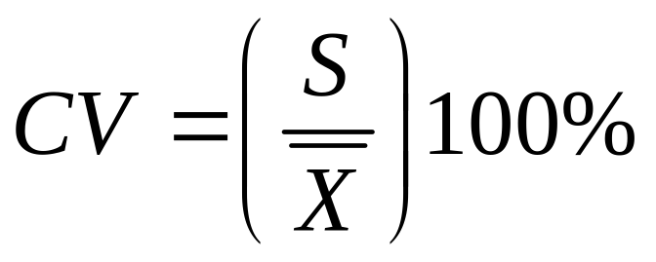
Coefficient of Variation
Measure of Relative Variation
Always in Percentage (%)
Shows Variation Relative to Mean
Used to Compare Two or More Sets of Data Measured in Different Units

Slide 20
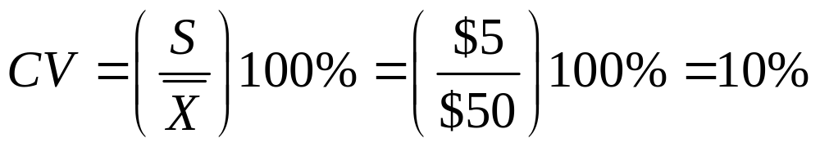
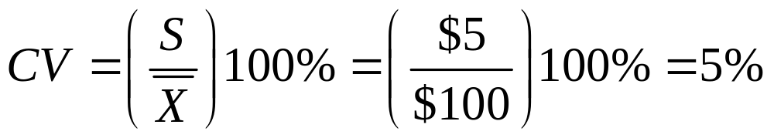
Comparing Coefficient of Variation
Stock A:
  Average price last year = $50
  Standard deviation = $5
Stock B:
  Average price last year = $100
  Standard deviation = $5
Coefficient of Variation:
  Stock A:
  Stock B:

Slide 21
Shape of a Distribution
Describe How Data are Distributed
Measures of Shape
  Symmetric or skewed
Left-Skewed
Symmetric
Right-Skewed
Mean < Median < Mode
Mean = Median =Mode
Mode < Median < Mean

Slide 22
Exploratory Data Analysis
Box-and-Whisker
  Graphical display of data using 5-number summary
Median( )
X
X
smallest
largest
4
6
8
10
12

Slide 23


Distribution Shape &
Box-and-Whisker
Left-Skewed
Symmetric
Right-Skewed

Slide 24
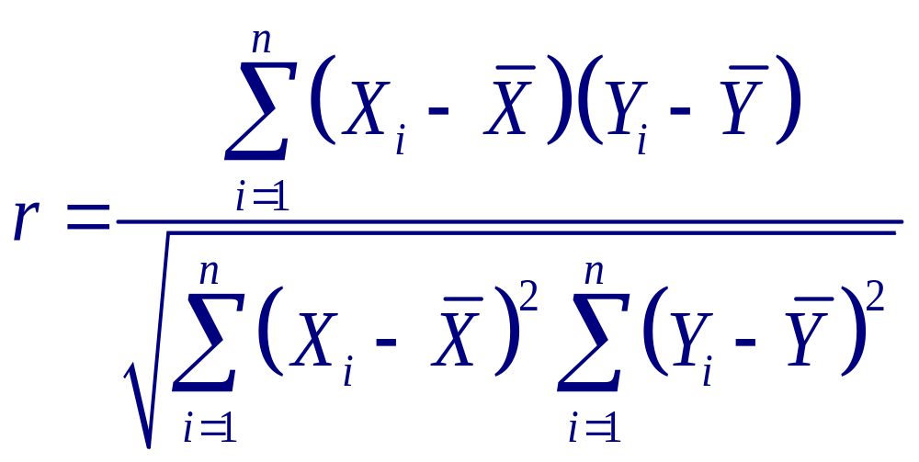
Coefficient of Correlation
Measures the Strength of the Linear Relationship between 2 Quantitative Variables

Slide 25
Features of Correlation Coefficient
Unit Free
Ranges between –1 and 1
The Closer to –1, the Stronger the Negative Linear Relationship
The Closer to 1, the Stronger the Positive Linear Relationship
The Closer to 0, the Weaker Any Linear Relationship

Slide 26
Scatter Plots of Data with Various Correlation Coefficients
Y
Y
Y
X
X
X
r = -1
r = -.6
r = 0
Y
Y
X
X
r = .6
r = 1

Slide 27
Pitfalls in Numerical Descriptive Measures and Ethical Issues
Data Analysis is Objective
  Should report the summary measures that best meet the assumptions about the data set
Data Interpretation is Subjective
  Should be done in fair, neutral and clear manner
Ethical Issues
  Should document both good and bad results
  Presentation should be fair, objective and neutral
  Should not use inappropriate summary measures to distort the facts

Slide 28
Chapter Summary
Described Measures of Central Tendency
  Mean, Median, Mode, Geometric Mean
Discussed Quartiles
Described Measures of Variation
  Range, Interquartile Range, Variance and Standard Deviation, Coefficient of variation
Illustrated Shape of Distribution
  Symmetric, Skewed, using Box-and-Whisker Plots

Slide 29
Chapter Summary
(continued)
Discussed Correlation Coefficient
Addressed Pitfalls in Numerical Descriptive Measures and Ethical Issues

